Slide 1
Indian Philosophical System Introduction to Vedas
The Vedas are ancient texts from India that hold great importance in the country's cultural and spiritual heritage. They are a collection of extremely old scriptures that were composed in Sanskrit, the ancient language of India.
Here's a simple introduction to the VedasThe Vedas are a set of very old books that contain hymns, prayers, rituals, and guidance. They are considered the oldest sacred texts in the world and are the foundation of Hindu philosophy and spiritual knowledge.
There are four Vedas: Rigveda, Samaveda, Yajurveda, and Atharvaveda. Each Veda is divided into different parts. The hymns and verses in these texts are dedicated to various gods and cover a wide range of topics, including rituals, ceremonies, prayers for peace, prosperity, and the understanding of the universe.These texts were originally passed down orally from generation to generation before being written down. They were highly revered and studied by ancient scholars and continue to be studied and respected by many even today.
The Vedas provide insights into ancient Indian culture, spiritual beliefs, and the practices followed by the people thousands of years ago. They have a profound impact not only on Hinduism but also on Indian society as a whole.

Slide 2
"Vadang" in simple terms, refers to different branches or fields of knowledge in ancient texts or scriptures, particularly in the context of Indian traditions or philosophical writings. It encompasses various disciplines or subjects that are studied or discussed within these texts, often covering subjects like science, philosophy, ethics, rituals, music, or other areas of learning. Essentially, it refers to the different categories or domains of knowledge or learning within a specific context, particularly in ancient texts or philosophical discussions
"Darsanas" are different schools of thought or philosophies from a
ncient Indian teachings. These philosophies offer various ways of understanding life, reality, and the universe. They explore different viewpoints on topics such as logic, the nature of existence, spirituality, and the study of ancient texts. Each darsana presents its own unique perspective on how to comprehend and navigate the complexities of the world and human existence.

Slide 3
Puranas: Puranas are ancient texts in Hinduism that consist of stories, myths, legends, and historical narratives. They often narrate the genealogies of gods, demigods, and heroes, along with cosmology, cosmogony, rituals, and moral teachings. Puranas cover a wide range of topics, including religious ceremonies, legends of gods and goddesses, and the history of ancient dynasties. They serve to impart moral and spiritual lessons through storytelling and are an essential part of Hindu religious literature.
Itihasas: The Itihasas refer to epic narratives in Hinduism, specifically the two most significant ones— the Ramayana and the Mahabharata. These epics narrate the tales of heroic figures, their triumphs, challenges, and moral dilemmas. The Ramayana tells the story of Lord Rama, his wife Sita, and his battle against the demon king Ravana. The Mahabharata focuses on the conflict between the Pandavas and Kauravas and includes the Bhagavad Gita. Both epics contain profound moral, ethical, and philosophical teachings and are considered guiding sources of wisdom and righteousness in Hinduism.

Slide 4
Dharma Shastras: Dharma Shastras are ancient texts that provide guidelines and rules for leading a righteous life. They cover moral and ethical codes of conduct, religious duties, social laws, and principles for individuals and society. These texts, written by sages and scholars, address various aspects of life, such as family, marriage, inheritance, governance, and personal conduct.
Smritis: Smritis are a category of texts that provide a collection of remembered or remembered knowledge. They cover legal, ethical, and social guidelines for living a virtuous life and are derived from remembered traditions, customs, and codes. Smritis often include practical guidance for individuals' conduct in society, legal matters, and social order, and they complement and expand upon the principles outlined in the Dharma Shastras.

Slide 5
The Four Vedas
The Vedas are ancient texts highly revered in Hinduism and considered the oldest scriptures in the world. They consist of a vast collection of hymns, prayers, rituals, and philosophical teachings. Here's a simple explanation:
Rigveda: The oldest Veda, containing hymns dedicated to various gods and natural forces. It
talks about rituals, prayers, and philosophical questions.
Samaveda: Consists of melodies and musical notations derived from the Rigveda. It's used
during rituals and ceremonies, focusing on the musical aspects of hymns.
Yajurveda: Offers guidelines for performing rituals and ceremonies. It includes instructions on sacrificial rites and prayers.
Atharvaveda: Includes spells, incantations, and prayers for healing, protection, and addressing everyday life issues. It's a collection of hymns for domestic rituals.

Slide 6
The Four divisions of each Veda
The Samhitas: This text consists of a collection of mantras, hymns and prayers. They constitute the core part of the Vedas. The Brahmanas consist of the commentaries and interpretations of themantras (Samhita). It is referred to as the Karma Kanda part of the Vedas.
The Aranyakas : The Aranyakas are a part of the ancient Indian Vedas concerned with the meaning of ritual sacrifice. They typically represent the later sections of the Vedas, and are one of many layers of Vedic texts.
The Brahmanas : It comes from the word Brahman which means both the Veda and the Mantra –“Brahma Vai Mantrah.” Thus the word Brahmana means 'that which relates to Brahman or the Veda'. It is derived from the root brih 'to grow', 'to expand'. In other words, the name 'Brahmana' means the explanation of a ritual by a learned priest
.The Upanishads: The Upanishads are part of a large collection of sacred books of Hindu people, called the Vedas. They are placed at the end of the Vedas and they primarily deal with knowledge or wisdom. Because they deal with knowledge portion of the Vedas, they are called Jnana-Kanda (Jnana means knowledge).

Slide 7
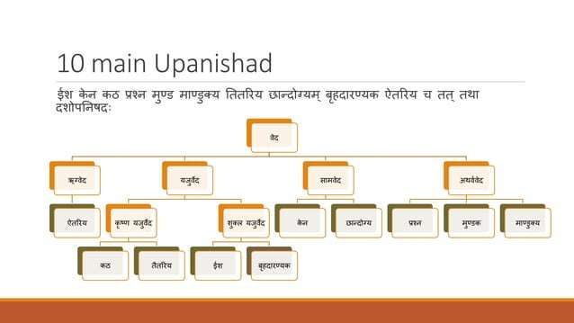

Slide 8
Vedic Life: Distinctive Features
Vedic life refers to the way of living, beliefs, practices, and traditions based on the principles outlined in the Vedas, the ancient sacred texts of India. It embodies the cultural, social, religious, and philosophical aspects of life as prescribed in these texts.
Dharma (Duty and Righteousness): Giving importance to fulfilling one's responsibilities and duties towards family, society, and oneself. Living in a way that upholds moral and ethical values.
Artha (Wealth and Prosperity): Understanding the significance of earning wealth and resources through rightful means to support oneself, family, and contribute to the welfare of society.
Kama (Desires and Enjoyment): Acknowledging the importance of desires and pleasures in life while ensuring they are pursued within ethical boundaries and do not overshadow one's duties and spiritual growth.
Respect for Nature: Vedic principles stress the importance of treating nature with reverence and understanding that humans are interconnected with the environment. It advocates for conserving natural resources and living in harmony with the ecosystem.

Slide 9
Yajna (Sacred Offerings): The practice of Yajna involves offering oblations into a sacred fire, symbolizing a sustainable cycle of giving back to nature. This ritual represents the balance between taking from the earth and giving back to maintain ecological harmony.
Ahinsa (Non-Violence): Vedic teachings promote non-violence and compassion towards all living beings. This philosophy extends to sustainable living by advocating for responsible consumption and minimizing harm to the environment and other creatu

Slide 10
Indian Philosophical System
Philosophy arose in India as an enquiry into the mystery of life and existence.
Indian Philosophy refers to several traditions of philosophical thought that originated in the Indian subcontinent.
Over centuries, India’s intellectual exploration of truth has come to be represented by six systems of philosophy. These are known as Vaishesika, Nyaya, Samkhya, Yoga, Purva Mimansa and Vedanta or Uttara Mimansa.
These six systems of philosophy are said to have been founded by sages Konada, Gotama, Kapila, Patanjali, Jaimini and Vyasa, respectively. These philosophies still guide scholarly discourse in the country.

Slide 11
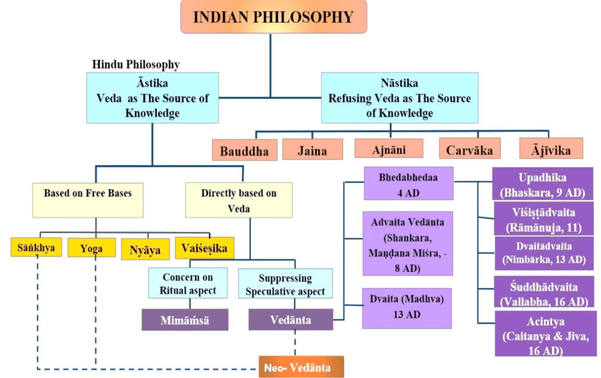

Slide 12
Astik:- In the Indian knowledge system, Astik schools are the orthodox philosophical traditions that accept the authority of the Vedas as the supreme source of knowledge. The Vedas are considered ancient, sacred scriptures that form the basis of classical Hinduism and contain hymns, ritual instructions, and philosophical insights, influencing various Astik systems like Nyaya, Yoga, Mimamsa, and Vedanta.
Nastik :- philosophy refers to heterodox schools of thought in Indian philosophy that reject the absolute authority of the Vedas as a source of knowledge or truth. Unlike Astika schools, which accept Vedic authority, Nastik schools include systems like Buddhism, Jainism, and Charvaka, which challenged traditional beliefs and are not necessarily atheistic, though they may question concepts like the afterlife or the efficacy of Vedic rituals.

Slide 13
Buddhism is a foundational element of the Indian Knowledge System (IKS), deeply influencing its ethical, philosophical, and cultural landscape. Originating in India, Buddhist principles emphasize compassion, non-violence, social responsibility, and interconnectedness, impacting Indian society and philosophy for over 2,500 years. Its influence is evident in Buddhist literature like the Tripitaka, art and architecture (e.g., Ajanta caves), and major learning centers like Nalanda, showcasing its role in shaping a holistic and interconnected knowledge tradition.
The Jaina knowledge system is an integral part of Indian tradition, focusing on liberation through right knowledge, faith, and conduct, emphasizing the soul's inherent omniscience. It uses three pramanas (means of knowledge)—perception, inference, and testimony—and classifies knowledge into mediate and immediate forms, with the ultimate goal of achieving Kevala Jnana (absolute knowledge). Key tenets include nonviolence (ahimsa), the doctrine of relativity (syadvada), and the veneration of Tirthankaras over a supreme god.

Slide 14
"Ajnan" does not appear as a concept within the "Indian Knowledge System" (IKS). The term "ajnani" (ajnani) actually means ignorant or someone lacking knowledge, in direct contrast to the IKS, which encompasses vast, evolving knowledge systems like the Vedas, Upanishads, and various arts, sciences, and traditions. The IKS Division of the Ministry of Education promotes the integration and dissemination of this "Jnan" (knowledge) for modern applications while preserving Indian heritage.
Understanding "Jnan" vs. "Ajnani"
Jnan (Knowledge):
This is the core concept of the IKS, referring to a holistic body of wisdom that includes intellectual, moral, physical, and spiritual development. It is often discussed in conjunction with "Vignan" (science) and "Jeevan Darshan" (philosophy of life).
Ajnani (Ignorant):
This term signifies the absence of "Jnan" or wisdom, making it a concept opposed to the principles of the Indian Knowledge System.

Slide 15
The Charvaka, or Lokāyata, is an ancient Indian, heterodox philosophical system that emphasizes materialism, empiricism, and hedonism, rejecting the authority of the Vedas and the existence of a soul, gods, or an afterlife. Its central doctrine is that perception (pratyakṣa) is the only valid source of knowledge, and it advocates for the pursuit of sensory pleasure in this life as the ultimate good.

Slide 16
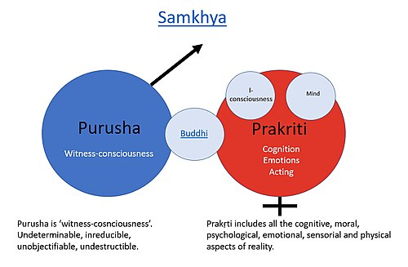

Slide 17
Samkhya (Kapila): Samkhya is the oldest of the orthodox philosophical systems, and it postulates that everything in reality stems from purusha (self, soul or mind) and prakriti (matter, creative agency, energy).
Purush cannot be modified or changed while prakriti brings change in all objects.
Key aspects of Samkhya dualism:
Purusha: Referred to as the self, spirit, or consciousness, Purusha is considered eternal, unchanging, and inactive. It is a passive observer, a pure witness to the activities of Prakriti.
Prakriti: Prakriti is the source of all material existence, encompassing the physical world, the mind, and the senses. It is dynamic, active, and composed of three fundamental qualities called gunas (Sattva, Rajas, and Tamas).

Slide 18
Dualism: Samkhya's dualism highlights the fundamental difference between Purusha and Prakriti, asserting that they are distinct and independent entities. This distinction is crucial for understanding the nature of reality and the path to liberation.
Plurality of Purushas: Unlike some other schools of thought, Samkhya believes in the existence of multiple Purushas, meaning each individual has their own distinct consciousness.
Causality: Samkhya proposes that the world arises from the interaction of Purusha and Prakriti. Prakriti, through the interplay of the gunas, creates the universe, while Purusha's presence is necessary for Prakriti to manifest.
Liberation (Kaivalya): Samkhya's goal is liberation from suffering, which is achieved through gaining knowledge of the true nature of Purusha and Prakriti and recognizing their distinct identities. This realization leads to the cessation of identification with Prakriti and the experience of pure consciousness.
In essence, Samkhya's dualism provides a framework for understanding the relationship between consciousness and the material world, offering a path to self-realization and liberation from suffering.

Slide 19
Yoga (Patanjali):
Yoga literally means the union of two principal entities. Yogic techniques control body, mind & sense organs, thus considered as a means of achieving freedom or mukti.
This freedom could be attained by practising self-control (yama), observation of rules (niyama), fixed postures (asana), breath control (pranayama), choosing an object (pratyahara) and fixing the mind (dharna), concentrating on the chosen object (dhyana) and complete dissolution of self, merging the mind and the object (Samadhi).
Yoga admits the existence of God as a teacher and guide.
Not an Invention:
Patanjali didn't create yoga itself, but rather compiled and systematized existing yogic practices and philosophical ideas.

Slide 20


Slide 21
Comprising 196 verses, these sutras delve into four principal themes: yoga as a lifestyle, key yogic principles (the eight limbs of yoga), yoga as a potent life force, and the pursuit of absolute fulfillment. The Yoga Sutras, Patanjali's spiritual roadmap, guide yogis on the journey to enlightenment.
YAMA - Restraints, moral disciplines or moral vows.
NIYAMA - Positive duties or observances.
ASANA - Posture.
PRANAYAMA - Breathing Techniques.
PRATYAHARA - Sense withdrawal.
DHARANA - Focused Concentration.
DHYANA - Meditative absorption.
SAMADHI - Bliss or Enlightenment.

Slide 22
YAMA : In yoga, Yama represents ethical disciplines or moral restraints, the first of the eight limbs of yoga as outlined by Patanjali in the Yoga Sutras. It focuses on how individuals interact with the external world, emphasizing ethical conduct and social harmony. The five Yamas are: Ahimsa (non-violence), Satya (truthfulness), Asteya (non-stealing), Brahmacharya (continence/self-control), and Aparigraha (non-greed/non-possessiveness).
Ahimsa (Non-violence):
This Yama emphasizes harmlessness and compassion towards all beings, including oneself. It encourages avoiding harm through thoughts, words, and actions.
Satya (Truthfulness):
Satya promotes honesty and truthfulness in all interactions, avoiding deceit and falsehoods. It also encompasses integrity and acting in accordance with one's inner truth.

Slide 23
Asteya (Non-stealing):
Asteya involves respecting the property of others and refraining from taking anything that is not freely given. It also extends to respecting boundaries and not taking advantage of others.
Brahmacharya (Continence/Self-control):
While often translated as celibacy, Brahmacharya is about self-control and moderation in all aspects of life, including sexual conduct. It encourages mindful use of energy and avoiding overindulgence.
Aparigraha (Non-greed/Non-possessiveness):
Aparigraha focuses on letting go of greed, attachment to material possessions, and the desire to accumulate. It encourages contentment, simplicity, and generosity.
By practicing the Yamas, individuals can cultivate a strong ethical foundation for their yoga practice and their interactions with the world, leading to a more harmonious and fulfilling life.

Slide 24
Nyaya (Gautama Muni):
Nyaya Philosophy states that nothing is acceptable unless it is in accordance with reason and experience (scientific approach). Nyaya is considered as a technique of logical thinking.
Nyaya Sutras say that there are four means of attaining valid knowledge: perception, inference, comparison, and verbal testimony.

Slide 25
Unit:- 4
Scientific Foundation in Linguistics

Slide 26
Scientific Foundations in Linguistics
1. Introduction to Linguistics as a Science
Linguistics is the scientific study of language, examining properties of specific languages and language in general using empirical, systematic methods. It connects with disciplines like cognitive science, psychology, anthropology, and computer science
Language as a System
Languages have rules and patterns:
Phonological rules (sound systems)
Morphological rules (word formation)
Syntactic rules (sentence structure)
Semantic rules (meaning)
Pragmatic rules (contextual use)
Branches of Linguistics
Phonetics – Study of speech sounds
Phonology – Patterns of sounds
Morphology – Structure of words
Syntax – Sentence structure
Semantics – Meaning of words and sentences
Pragmatics – Language use in context

Slide 27
Language as a System
Languages have rules and patterns
Language is not random; it is structured and governed by a set of rules that make communication possible and meaningful. These rules create consistency across speakers, allowing us to understand each other. Let’s look at the main types
Phonological rules (sound systems)
Concerned with the organization of sounds in a language.
Every language has a unique phonemic inventory (set of distinct sounds).

Slide 28
Morphological Rules (Word Formation)
Morphological rules govern how words are formed in a language by combining smaller units of meaning called morphemes. These rules define processes such as derivation (e.g., adding "un-" to "do" to form "undo") and compounding (e.g., "black" + "board" = "blackboard"), as well as inflection (e.g., adding "-s" to "dog" to form "dogs") which changes a word's grammatical function rather than its core meaning or class.
Deal with the structure of words and how smaller units of meaning (morphemes) combine.

Slide 29
Syntactic rules (sentence structure)
Syntactic rules, or rules of syntax, govern how words are arranged to form grammatical phrases, clauses, and sentences, ensuring meaning in a language. The fundamental rule in English is the Subject-Verb-Object (SVO) word order, where the subject performs an action (verb) on an object. Key elements are the subject (who/what performs the action), the verb (the action or state of being), and the object (what receives the action). A complete sentence requires at least a subject and a verb to express a complete thought.
Semantic rules (meaning)
Semantic rules are principles that govern the meaning and interpretation of language, dictating how words, phrases, and symbols are used to convey specific understandings in communication. These rules define the relationship between symbols and the world, including how word meanings and their combination determine the meaning of a sentence, a concept known as compositional semantics. Semantic rules are found in both linguistics and computer science, where they are used in compiler design to ensure a program's logic is meaningful beyond its grammatical structure.

Slide 30
Pragmatic rules (contextual use)
Pragmatic rules are the unstated principles people use to interpret the contextual or implied meaning of language, going beyond literal definitions to understand social, situational, and cultural factors. These rules govern how speakers and listeners infer meaning, for example, in politeness, turn-taking, and understanding sarcasm, allowing for effective communication even when meaning is not explicitly stated. Key aspects include interpreting implied meanings (conversational implicature) and adjusting language based on shared context, such as social relationships and physical environment.

Slide 31
2. Scientific Methodology in Linguistics
Steps:
Observation – Patterns in spoken or written language
Hypothesis – Possible explanations or rules
Data Collection – Through fieldwork, recordings, corpora, experiments
Analysis and Testing – Rule validation and generalization
Theory Building – Explaining linguistic universals and variation
Types of Data:
Introspective: Speaker’s intuition (used in syntax)
Empirical: Spoken/written data from native speakers
Experimental: Psycholinguistic or neurolinguistic studies

Slide 32
Observing patterns in spoken and written language involves noticing regularities in grammar, vocabulary, and communication styles to improve understanding and learning.
A hypothesis is a proposed explanation for a phenomenon, serving as a foundational element of the scientific method. It is characterized by its provisional nature, meaning it is not a definitive truth but rather a possible truth that can be tested through experiments or other forms of evidence gathering.
Data collection encompasses fieldwork, recordings, corpora, and experiments, each offering distinct ways to gather information. Fieldwork involves firsthand, ground-level observation, while recordings capture real-time audio and video data. Corpora are large, pre-compiled collections of texts or audio/video for analysis. Experiments involve systematically manipulating variables to observe their effects, allowing for controlled data collection.

Slide 33
Rule validation and generalization involves validating the accuracy of a rule or model to ensure it functions correctly in its intended context and generalizing that rule or model's performance to new, unseen data by assessing its ability to adapt to diverse populations and varied environments, which is a critical step in ensuring robustness and applicability in real-world scenarios, particularly in fields like artificial intelligence (AI) and data mining.
Theory building to explain linguistic universals and variation draws on two main frameworks: Universal Grammar (UG), which posits innate, shared principles governing all languages, and Language Typology, which examines patterns of similarities and differences across languages through large datasets to understand constraints on variation

Slide 34
Types of Data:
Introspective: Speaker’s intuition (used in syntax):
In syntax, "introspective" refers to a linguist's use of their own internal, unconscious linguistic knowledge to make judgments about the grammaticality or meaning of a sentence. These "speaker's intuitions" are a foundational, albeit debated, method of gathering data in linguistics, particularly within generative grammar, to understand the speaker's "mind/brain". While it's a direct way to access linguistic structure, it faces challenges as an empirical science due to its subjective nature.
Empirical: Spoken/written data from native speakers:
Mandarin Chinese has the most native speakers in the world, with close to 940 million native speakers, primarily in China. This is followed by Spanish, with approximately 460 to 484 million native speakers, and then Hindi and English, which have around 345 to 375 million native speakers each.

Slide 35
Experimental: Psycholinguistic or neurolinguistic studies
Experimental psycholinguistic studies use controlled experiments and reaction time measures to test models of language perception and production, while neurolinguistic studies combine psycholinguistic theories with brain imaging (like EEG/ERP, fMRI) and lesion studies to map language functions to specific brain regions and networks. Both fields are deeply intertwined, with neurolinguistics often validating psycholinguistic hypotheses by analyzing brain activity during language tasks.

Slide 36
3.Core Theories in Linguistics:
The three core theoretical approaches to understanding language, particularly language acquisition, are the Nativist theory, which posits an innate language capacity; the Learning (Behaviorist) theory, which emphasizes imitation and conditioning; and the Social Interactionist theory, which highlights the role of social context and interaction. Other key areas within theoretical linguistics, focusing on the structure and rules of language itself, include phonology (sound systems), morphology (word structure), syntax (sentence structure), and semantics (meaning)
Structuralism (Saussure, Bloomfield):
Language as a system of signs
Importance of structure over meaning
Language = langue (system) vs parole (speech)

Slide 37
Language as a system of signs:
Language is a system of signs because its meaning comes from the structured relationships between arbitrary signs, rather than from inherent connections to reality, according to Swiss linguist Ferdinand de Saussure. Each linguistic sign consists of a signifier (the sound-image or form) and a signified (the concept it represents), with their connection being arbitrary and established through their contrast with other signs within the language system. This perspective, central to the field of semiotics or semiology, views language as an autonomous, self-contained structure that can be studied independently.
Importance of structure over meaning:
The structure also makes operations more efficient and much more effective. The company can seamlessly perform different operations at once by separating employees and functions into separate departments. A very clear organizational structure also informs employees on how best to get their jobs done.

Slide 38
Language = langue (system) vs parole (speech)
In linguistic theory by Ferdinand de Saussure, langue is the abstract, social system of a language's rules and conventions, while parole is the concrete, individual act of using that language through speech or writing. Langue is the collective, universal structure that allows communication to happen, existing independently of any single speaker, whereas parole is the unique, personal realization of that system, influenced by individual factors and context.

Slide 39
Generative Grammar (Chomsky):
Competence (knowledge of language)
Performance (use of language in real situations)
Cognitive Linguistics:
Language is part of general cognition
Meaning is shaped by conceptual metaphors and mental schemas
4. Language and the Mind (Psycholinguistics & Neurolinguistics)
How the Brain Processes Language:
Key brain regions: Broca’s Area, Wernicke’s Area Studies on aphasia (language disorders) show modular nature of language in the brain
Language and Thought:
Sapir-Whorf Hypothesis:
Language influences thought (linguistic relativity) Strong version (language determines thought) is less accepted
Psycholinguistics: Psycholinguistics is a field that combines methods and theories from psychology and linguistics to derive a fuller understanding of human language. From psychology, it inherits experimental methodology and a body of knowledge about processes in perception, memory, attention, learning, and problem-solving.

Slide 40
Neurolinguistics:
Neurolinguistics is the field of study that examines the connection between the brain and language. It focuses on understanding how the brain processes and produces language, particularly when there is damage or impairment in these functions.
5. Tools and Techniques in Linguistic Research
➤ Phonetic Tools:
IPA (International Phonetic Alphabet): Represents speech sounds Praat software: Analyzing audio and pitch
➤ Syntactic Tools:
Syntax trees: Visualize sentence structure (constituents and phrases)

Slide 41
6. Indian Contributions to Scientific Linguistics
➤ Pāṇini's Aṣṭādhyāyī (~500 BCE):
One of the earliest and most complete formal grammars
4000+ concise rules (sūtras) governing Sanskrit
Based on:
Dhātu (root)
Pratyaya (suffix)
Sandhi (phonological rules)
Uses meta-rules (Paribhāṣā) and rule-ordering
Scientific Nature of Pāṇini's Grammar:
Comparable to modern formal language theory
Rule-based, generative, and complete
Influenced 20th-century linguists like Frits Staal and Noam Chomsky
7. Linguistics and Interdisciplinary Science
➤ Artificial Intelligence & NLP:
Speech recognition, chatbots, machine translation
Syntax trees and semantic analysis applied in AI
➤ Language and Evolution:
Comparative studies of human and animal communication
Evolution of the FOXP2 gene and language capacity
➤ Language and Education:
Applications in literacy development, bilingual education, dyslexia diagnosis
➤ Language and Data Science:
Text mining, sentiment analysis, chatbots
Language models (e.g., GPT) are built on linguistic principles

